Slide 1

HACKREFINE
Team PASS
Aditya Singh
Parth Kothari
Sahaj Gupta
Suvan Banerjee

Slide 2
The
Idea
01

Slide 3
Problem Statement
Most plant pathologies have visible symptoms, so the naked eye examination of a trained professional is the prime technique adopted in practice for plant disease detection.
An automated system designed to help identify plant diseases by the plant’s appearance and visual symptoms could be of great help to amateurs in the gardening process and also trained professionals as a veriﬁcation system in disease diagnostics.
Various approaches are currently used for detecting plant diseases and most common are Artiﬁcial Neural Networks (ANNs) and Support Vector Machines (SVMs). Exploiting common digital image processing techniques such as colour analysis and thresholding were used with the aim of detection and classiﬁcation of plant diseases.

Slide 4
Our Solution

Slide 5
Technology Used
Python
TensorFlow
Web Dev
Git/Github
Approach
Our approach to building the plant disease detection system involves a seamless integration of machine learning and web development technologies. The journey begins when the user uploads a plant image through the user-friendly frontend, built using Flask. The backend, equipped with Python, receives the uploaded image and initiates a series of processes. The image undergoes preprocessing to enhance its suitability for the machine learning model, which is loaded to make a prediction regarding the presence of any disease. The user is then presented with a clear and informative display of the detected disease.
For ML models
Training CNN Model
For Frontend
Workflow

Slide 6

03
Flowchart

Slide 7
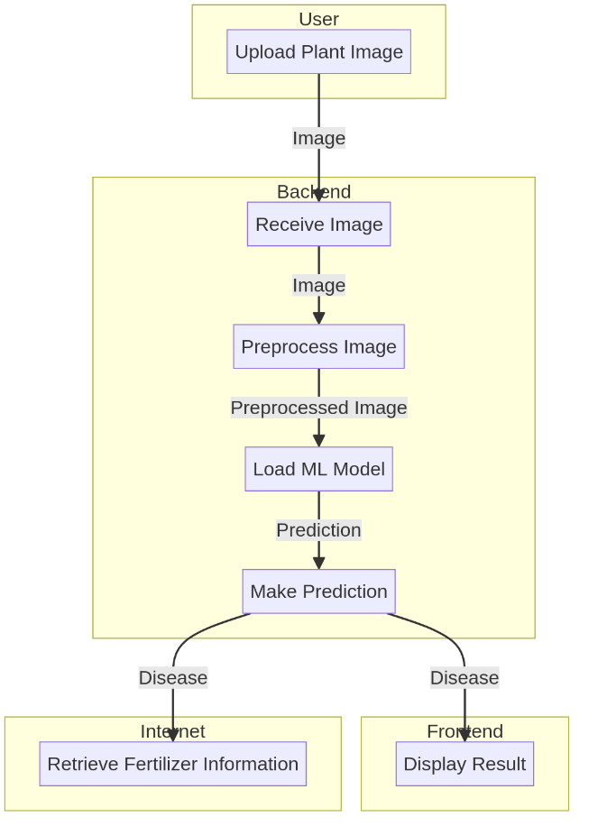

Slide 8

Thanks!
Please keep this slide for attribution

